Slide 1
Welcome to Class 2
years 1 and 2

Slide 2
What’s important to us
Every child is settled into their new class and that they feel happy and safe.
Every child reaches their full potential. They flourish
Children learn to be part of school life e.g. interacting with others, gaining confidence, thinking about others, working in a partnership.

Slide 3
We learn through a fun and supportive environment, using concrete materials and resources to support learning.
Emphasis on active learning through talking and doing and having learning experiences that they remember. Making learning stick.
We build upon children’s past learning and interests. Our curriculum is progressive and well planned.
We realise that every child is different.
Every child is celebrated and nurtured and prepared to enter KS2 by the end of year 2.

Slide 4
Our normal daily routines
8:40 children come into school and get settled
8:45 Register
8:55 – 9:55 RWI/literacy or maths
10:00 – 10:15 Worship (Monday 8:55am)
10:15-10:30 Playtime
10:30-11:50 Maths /or literacy and reading
12:00-1:00 Lunch
1:00-2:30 Foundation subjects, e.g Science and RE
Active learning and playtime is built into the afternoon at a time suitable for individual classes.

Slide 5
Information to parents/carers
At the beginning of each term we send home an information to parents/carers sheet. This gives you information about some of the learning we will be doing over the term.
We follow a long term plan that covers all of the national curriculum for year 1 and 2.
The year 2 children in different classes will cover the same learning objectives over the year.

Slide 6
Other information
Health and well-being is very important to us (our 5 ways to flourish). Our first aim is get the children settled into the classroom.
We have a robust PSHE curriculum with health and well-being integrated throughout our curriculum. We use an excellent programme called Jigsaw to support this teaching throughout the school.
We realise the importance of sports and exercise with regular spurts of exercise throughout the day to keep our brains and bodies active.

Slide 7
Growth mind-set and metacognition
We teach the children about growth mind-set and metacognition. All children can achieve, it may be a little difficult and at times a bumpy journey, but we can all get there if we show resilience and perseverance.
We talk to them about the process of learning…thinking about thinking.
If they get things wrong, children have to realise that it’s fine. It’s how we all learn and we develop strategies to help us.
We talk about our learning and celebrate our learning process.
Rewards are given sometimes through stickers, sometimes showing work and sometimes golden tickets but there is a large emphasis on praising the effort and celebrating individual progress.

Slide 8
What happens in the classroom?
We believe passionately about making sure every child develops a love of learning.
In the morning children work successfully in smaller groups and to can be taught year groups objectives.
The year 1 children are taught reading and writing through the RWI programme Monday – Friday by Miss Krzyszkowiak, and Mrs Hornsby. Maths is taught (Mon-Fri) by Miss Krzyszkowiak and supported by Mrs Hornsby, allowing for lots of talk, movement and fantastic, engaging maths learning.
The year 2 children from class 2 and 3 are taught together for English and Maths daily by Mrs Ramsdale.

Slide 9
Maths
We use the Singapore mastery approach to maths teaching and learning supported through the resource ‘ maths no problem’ in both year 1 and year 2.
The mastery approach ensures that children have a solid understanding of concepts, building links between their learning and talking about their thinking. The children work with concrete materials alongside pictorial images to embed understanding and move towards more abstract thinking.
Each lesson will begin with an ‘anchor task’ or ‘maths story’ which gives the children opportunities to reinforce learning and to think through problems.

Slide 10
Fluency facts
Learning fluency facts really benefits children. We teach addition and subtraction using concrete materials and give them visual images. This supports them in developing strategies to help them remember number facts without the need to use fingers.
The following slide show the fluency charts that we use in school. We use the number sense programme to support our teaching. This teachers children mathematical facts in a systematic manner much like the RWI phonic teaching.

Slide 11
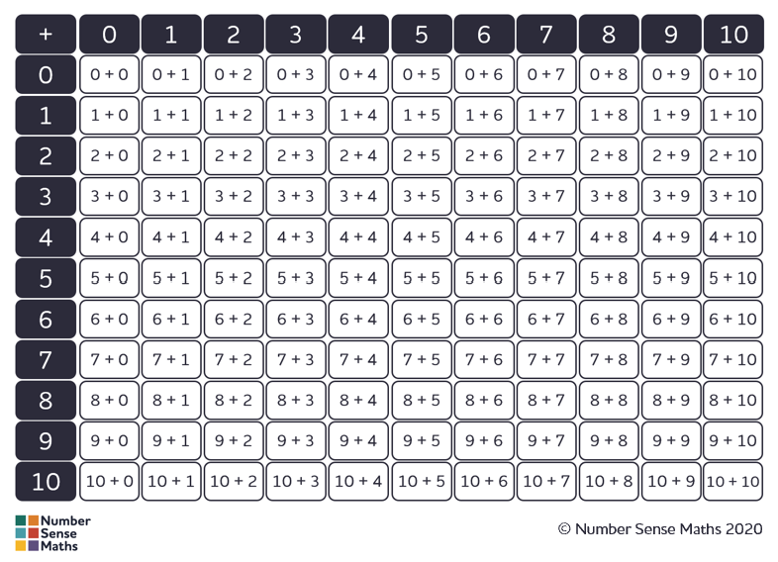

Slide 12
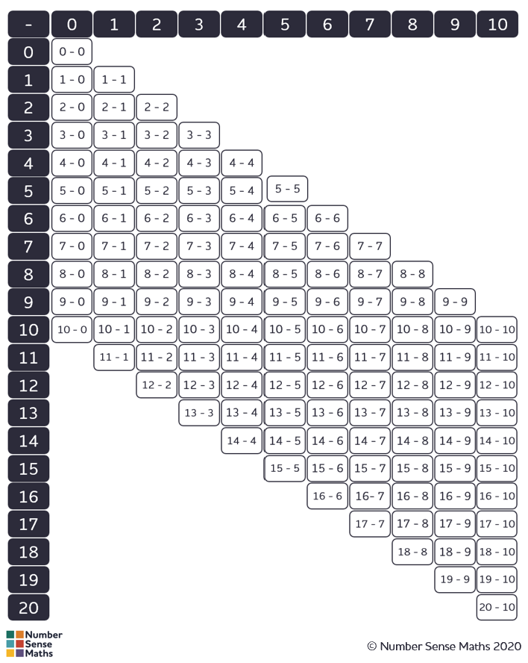

Slide 13
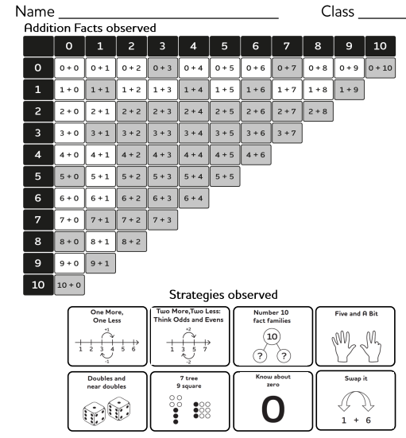

Slide 14
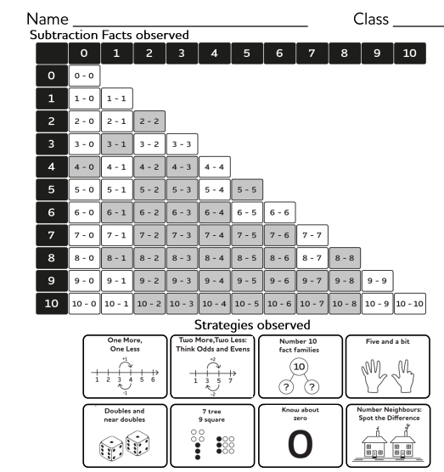

Slide 15
Mathematical strategies
We use different strategies to teach fluency.
We will send you information about what your child is working on for the half term so that you can support them at home.

Slide 16
Place value
Place value is another important concept.
We learn that 32 is a two digit number
We learn that 32 has 3 tens and 2 ones (units)
We learn that 32 is 30 + 2
We learn that the digit 3 in 32 represents 30 and 2 in 32 represents 2

Slide 17
Assessments in Year 1 and Year 2
The year one children take part in the phonics screen check in June.
The year 2 children have end of KS1 tests in May, but these only play a part in end of year judgements, as judgements are based on teacher assessment.
Teacher assessments happens on a daily basis as we work with your child and understand their next steps in learning.
These are just part of the classroom routines.

Slide 18
Homework
Maths – work on developing fluency facts e.g. counting, number bonds. We will send home the fluency chart (addition and subtraction) for you to work on. We will let you know each half term the specific facts that we are focusing on.
In year 2 in Autumn 2 year 2 children will start to learn multiplication and division facts for 2x,5x and 10x alongside the addition and subtraction facts.
We subscribe to an online resource called Numbots to support you at home. For most effective practice, we suggest playing for at least 3 minutes a day, 4 or 5 times a week. This supports the number sense learning.

Slide 19
Reading and spelling
All children need to read a little bit most nights (5x a week) RWI books and also books from the shelf (when ready).
Please encourage your child to read aloud to an adult as this develops accuracy and comprehension.
Please write in the reading records, even if it is just the name of the book.
Talk to your child about the vocabulary used and about the story, ask about characters, settings etc to develop comprehension skills.
From year 1 the children have regular spelling homework. Additional information is shared with you about how this is organised and how you can support your child. We give out new spellings on a Friday.

Slide 20
Safe guarding – keeping children safe while on line
Please ensure that your child is safe online.
Please have the thought that it could happen to you and every precaution should be taken for keeping your child safe using the internet.
We teach internet safety regularly in school, but you also need to have conversations with your children and have things in place to keep them safe.
The nspcc internet site has some very useful information on how to talk to your child about internet safety and practical steps you can take to keep your child safe.
https://www.nspcc.org.uk/
Please do spend some time reading through this information.

Slide 22
5 ways to flourish

